Slide 1
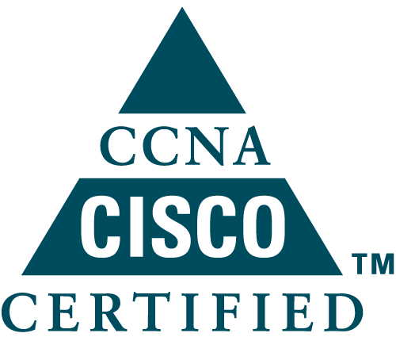
SUMMER TRAINING PROJECT PRESENTATION
ON
CISCO CERTIFIED NETWORK ASSOCIATE

Slide 2
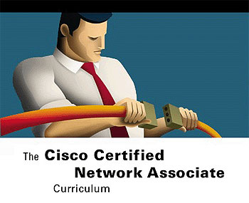
ABOUT CCNA
This certification builds a foundation in and apprentice knowledge of networking.
CCNA certified professionals can install, configure, and operate LAN, WAN and dail access services for small networks (100 modes or fewer), including but not limited to use of these protocols: IP, IGRP, SERIAL FRAME-RELAY, IP RIP, VLANs, RIP ETHERNET, ACCESS-LISTS.

Slide 3

NETWORKING DEVICES
Hubs:-
Centralized device in a topology.
Take incoming signal and repeats it out to all ports on networks.
A multi port twisted pair hub allows several point to point segments to be joined in to one network.

Slide 4
Switches:-
Used to interconnect LAN segment in cheap and easily configured manner.
Reduces network traffic resuting from an excessive number of computers.
Routers:-
Segment large number of data into smaller segments.
Acts as safety barrier between segments.
Perform complex operation, they are than Switches.
Performing path selection in WAN Technology

Slide 5
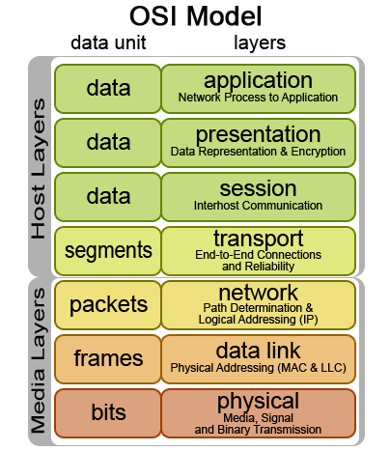
OSI MODEL
Open System Interconnection reference model developed by the International Organization for Standardization (ISO).
OSI model describes how data is transferred from an application on one computer to another.
OSI model composed of seven layers that describe the functions of data communication protocols.
Each Layer of OSI model describes a particular network function.

Slide 6

IP ADDRESS
An IP address is a numeric identifier assigned to each machine on an IP network.
It designates the specific location of a device on the network.
IP addressing was designed to allow hosts on one network to communicate with a host on a different network regardless of the type of LANs the hosts are participating in.

Slide 7
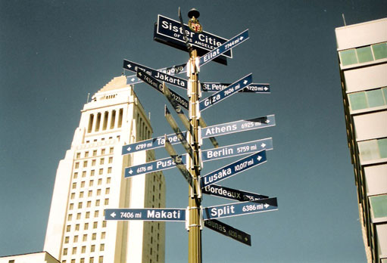
ROUTING
The term routing is used for taking a packet from one device and sending it through the network to another devices of different network.
The logical network address of the destination host is used to get packets to the network through a routed network, and then the hardware address of the host is used to deliver the packet from a router to the correct destination host.

Slide 8
If a network isn’t connected to the router the router must use one of the two ways to learn how to get to the remote network.
Static Routing:-
Meaning that someone must hand-type all network locations into the routing table.
Dynamic Routing:-
A protocol on one router communicates with the same protocol running on neighbor routers.
Dynamic Routing Protocols:-
RIP (Routing Information Protocol)
EIGRP (Enhanced Interior Gateway Routing Protocol)
OSPF (Open Shortest Path First)

Slide 9
ACCESS-LIST
Access control list are an integral part of Cisco’s Security Solution.
The proper use and configuration of access-lists is a vital part of router configuration because access lists are such versatile networking accessories.
Two type of access-lists:-
Standard access lists:-
These use only the source IP address in an IP packet as the condition test. All decisions are made based on source IP address.
Extended access lists:-
Extended access-list can evaluate many of the other fields in the layer 3 and layer 4 header of an IP packet.

Slide 10
NETWORK ADDRESS TRANSLATION (NAT)
The intention for NAT was to slow the depletion of available IP address space by allowing many private IP addresses to be representation by some smaller number of public IP address.
NAT is great to have around when an organization changes its ISP and network mangers doesn't want to hassle of changing the internal scheme.
Three Type of NAT:-
Static NAT:-
This type of NAT is designed to allow one to one mapping between local and global address.

Slide 11
Dynamic NAT:-
This version gives you to the ability to map unregistered IP address to a register IP address fro out of a pool of register IP addresses.
Overloading:-
This is the most popular type of NAT configuration. Understanding that overloading really is a form of dynamic NAT that maps multiple unregistered IP addresses to a single registered IP address by using different ports. Its also known as Port Address Translation (PAT).

Slide 12
SWITCHES
Layer 2 switching is the process o using the hardware address of devices on LAN to segment a network.
Create a Mac-address forward/filter table in order to make decisions on whether to forward or flood a frame.
In multiple links between switches we face multi looping problems. To solve this problem switches run Spanning Tree Protocol (STP).
The main purpose of STP is to prevent switching loops in a network with redundant switched paths.

Slide 13
Virtual LAN (VLAN)
A VLAN is a logical grouping of network users and resources connected to administratively defined ports on a switched.
A group of users that need an unusually high level of security can be put into its own VLAN so that users outside of the VLAN can’t communicate with them. So it provide security.
VLAN increase the number of broadcast domains while decreasing their size.
Network adds, moves, and changes are achieved with ease by just configuring a port into the appropriate VLAN.

Slide 14
VLAN Trunking Protocol (VTP)
This is created by CISCO.
Consistent VLAN configuration across all switches in the network.
VLAN trunking over mixed networks, such as Ethernet.
Accurate tracking and monitoring of VLAN’s.
Dynamic reporting of added VLANs to all switches in the VTP Domain.
Plug and play VLAN adding.
Three type of Mode:-
Server Mode
Client Mode
Transparent Mode

Slide 15
Wide Area Network (WAN)
WAN is depend upon Geographical distance.
WAN Terms:-
Customer premises equipment (CPE):-
Customer premises equipment (CPE) is equipment that’s owned by the subscriber and located on the subscriber’s premises.
Demarcation point:-
The demarcation point is the precise spot where the service provider’s responsibility ends and the CPE begins.
Central office (CO):-
This point connects the customer’s network to the provider’s switching network. Good to know is that a central office (CO) is sometimes referred to as a point of presence (POP).

Slide 16
WAN Connection Types
Leased lines:-These are usually referred to as a point-to-point or dedicated connection. When you’ve got plenty of cash, this is really the way to go because it uses synchronous serial lines up to 45Mbps. HDLC and PPP encapsulations are frequently used on leased lines.
Circuit switching:-When you hear the term circuit switching, think phone call. The big advantage is cost—you only pay for the time you actually use. No data can transfer before an end-to-end connection is established. Circuit switching uses dial-up modems or ISDN and is used for low-bandwidth data transfers.
Packet switching:-This is a WAN switching method that allows you to share bandwidth with other companies to save money. Frame Relay and X.25 are packet-switching technologies with speeds that can range from 56Kbps up to T3 (45Mbps).

Slide 17
Frame Relay:-
A packet-switched technology that made its debut in the early 1990s, Frame Relay is a high-performance Data Link and Physical layer specification. An upside to Frame Relay is that it can be more cost effective than point-to-point links, plus it typically runs at speeds of 64Kbps up to 45Mbps (T3). Another Frame Relay benefit is that it provides features for dynamic bandwidth allocation and congestion control.
HDLC High-Level Data-Link Control (HDLC):-
HDLC was derived from Synchronous Data Link Control (SDLC), which was created by IBM as a Data Link connection protocol. HDLC works at the Data Link layer. It wasn’t intended to encapsulate multiple Network layer protocols across the same link.

Slide 18
Point-to-Point Protocol (PPP):-
PPP is a pretty famous, industry-standard protocol. Because
all multi protocol versions of HDLC are proprietary, PPP can be used to create point-to-point links between different vendors’ equipment. It uses a Network Control Protocol field in the
Data Link header to identify the Network layer protocol and allows authentication and multi link connections to be run over asynchronous and synchronous links.

Slide 19
WIRELESS TECHNOLOGY
Transmitting a signal using the typical 802.11 specifications works a lot like it does with a basic Ethernet hub: They’re both two-way forms of communication, and they both use the same frequency to both transmit and receive.
Also important to note is the fact that the 802.11 specifications were developed so that there would be no licensing required in most countries—to ensure the user the freedom to install and operate without any licensing or operating fees.
Various agencies have been around for a very long time to help govern the use of wireless devices, frequencies, standards, and how the frequency spectrums are used.
Because WLANs transmit over radio frequencies, they’re regulated by the same types of laws used to govern things like AM/FM radios.

Slide 20
The 802.11 Standards:-
Wireless starts with 802.11, and there are various other up-and-coming standard groups as well, like 802.16 and 802.20. And there’s no doubt that cellular networks will become huge players in our wireless future. But for now, we’re going to concentrate on the 802.11 standards committee and subcommittees.
IEEE 802.11 was the first, original standardized WLAN at 1 and 2Mbps. It runs in the 2.4GHz radio frequency and was ratified in 1997 even though we didn’t see many products pop up until around 1999 when 802.11b was introduced.

Slide 21
Comparing 802.11:-
802.11b 802.11g 802.11a (h)
2.4GHz 2.4GHz 5GHz
Most common Higher throughput Highest throughput
Up to 11Mpbs Up to 54Mbps* Up to 54Mbps
DSSS DSSS/OFDM OFDM
3 non-overlapping 3 non-overlapping channels up to 23
Channels. Non-overlapping channels.

Slide 22
THANK YOU

